Slide 1
Simulated GOLD Observations of Atmospheric Waves
John Correira¹, J. Scott Evans¹, Jerry D. Lumpe¹,
Mihail Codrescu², David W. Rusch³, Amal Chandran³,
Richard Eastes⁴, and the GOLD Science Team
Computational Physics, Inc.
NOAA Space Weather Prediction Center
Laboratory for Atmospheric and Space Physics, University of Colorado
Florida Space Institute, University of Central Florida
Notes:
Acknowledge Dave & Amal for helping get early version of this effort started. Thank Mihail for providing CTIPe model results.
Ended up being more about ‘Simulated GOLD observations’ than ‘Atmospheric Waves’

Slide 2
Overview
GOLD Day Disk Data
Simulations
L1C Data
Model O/N₂
Level 2 Derived O/N₂

Slide 3
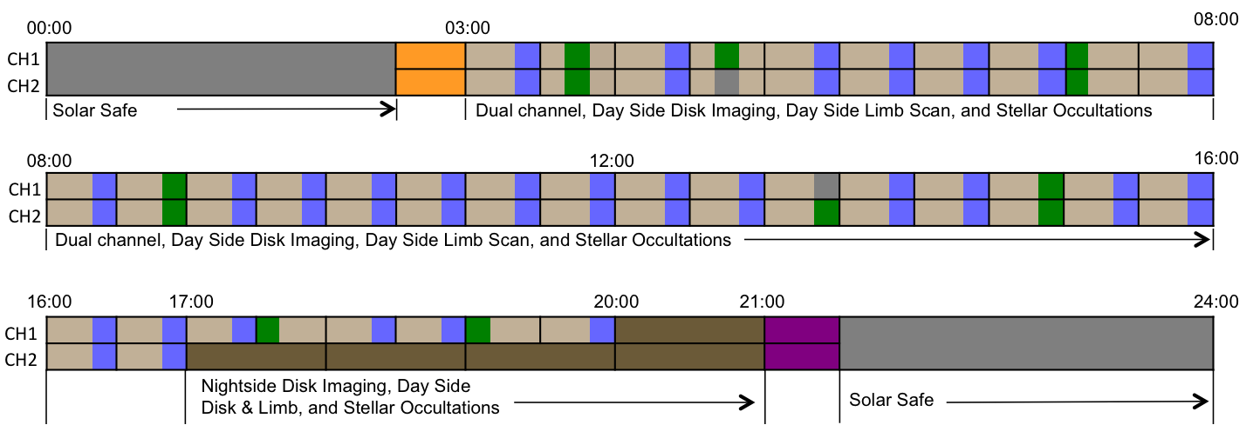
GOLD Disk Measurement Schedule
Spacecraft Local Time
Day Disk
24 minutes/scan
Occultation
Limb
Notes:
24 minutes per scan + 6 minutes for Occ or Limb = 30 minute cadence

Slide 4
Simulations
Solar spectra
NRLEUV scaled by SEE
Atmosphere
CTIPe
Ionosphere
IRI
AURIC upper atmospheric radiance modeling from the FUV to the NIR [Strickland et al., 1999]
Also used for testing Level 2 pipeline and algorithm codes
GNU parallel allowed work to be distributed over 100 cores
L1C & L2 data will be NetCDF
Geolocation
SPICE
AURIC
volume emission rates
Simulated L1C files
L1C into data processing pipeline
LOSI_3D
database
atomic emissions
AURIC N₂ LBH model
Simulated L2 files
LOS integration
Notes:
Time varying solar spectra, can and will simulate flares
Note that LOSI_3D handles the atomic emissions

Slide 5
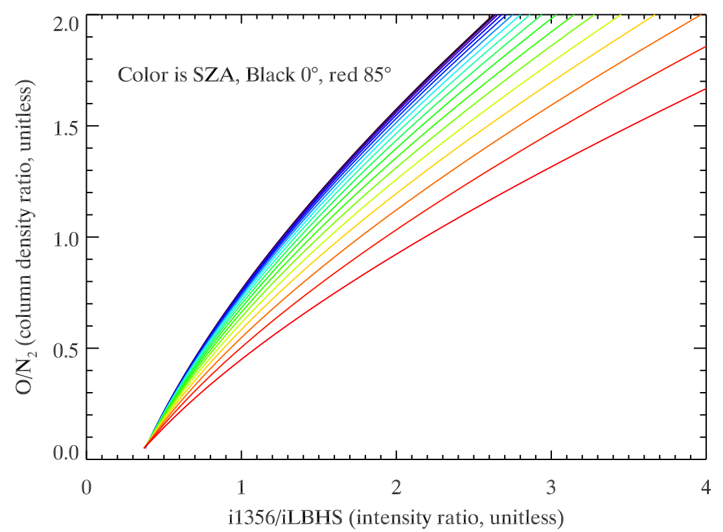
O/N₂ Algorithm
Ratio of column density of O above the altitude where the N₂ column density is 10¹⁷ cm⁻²
Intensity ratio & SZA uniquely specifies O/N₂
Inputs: 1356/LBH intensity ratio, uncertainties, SZA, look up table
Signature of atmospheric dynamics
GOLD spectral resolution allows for flexibility in choosing best LBH bands
Strickland, Evans, and Paxton, JGR, 100, A7, 1995

Slide 6
Model O/N₂
CTIPe results for 25 Oct 2015
DOY 298
10 minute cadence
Could use to implement time variation of atmosphere during course of single scan
18° longitude spacing
2° latitude spacing
Altitude range 75 km ~ 415 km

Slide 7
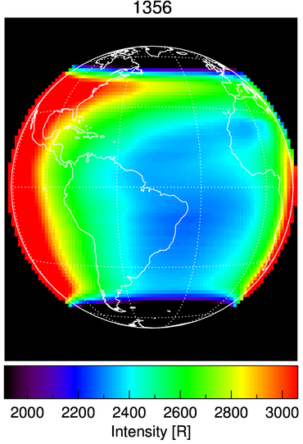
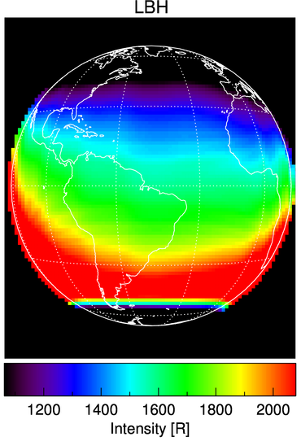
Example L1C data
DOY 298, UT 1500, LT 1200
125 km x 125 km @ nadir
Hemispheres scanned separately
Slit will overlap 1 degree at equator
Both hemispheres included in L1C & L2 files
Combined here
LBH roughly equivalent to GUVI LBH ‘Short’ (141 - 154 nm)
Notes:
Note disk scan starts two steps off disk.
Two hemispheres not temporally coincident in real data.
Auroral emssions not included at this stage, will be included in the future (algorithms required an auroral contamination flag)
This is not pixelation of the image, this is the L1C grid

Slide 8
Level 2 O/N₂ data
250 km x 250 km @ nadir
2x2 binning of Level 1C data
Constraints
SZA < 80°
Emission Angle < 75°
Currently emission angle effects are not included in look up tables.

Slide 9
Summary
Simulations will help demonstrate the feasibility of detecting various atmospheric phenomena.
Multi purpose
Test algorithms
Observation strategies
Provide realistic data processing pipeline codes
Future work
Incorporate instrument
Auroral emissions
Solar flares
Notes:
Simulated O/N2 suggest interesting features will be observable

Slide 10
Extra Slides

Slide 11
1356 disk only

Slide 12
1356 with limb

Slide 13
LBH disk only

Slide 14
LBH with limb

Slide 15
1356/LBH Intensity Ratio

