Slide 1
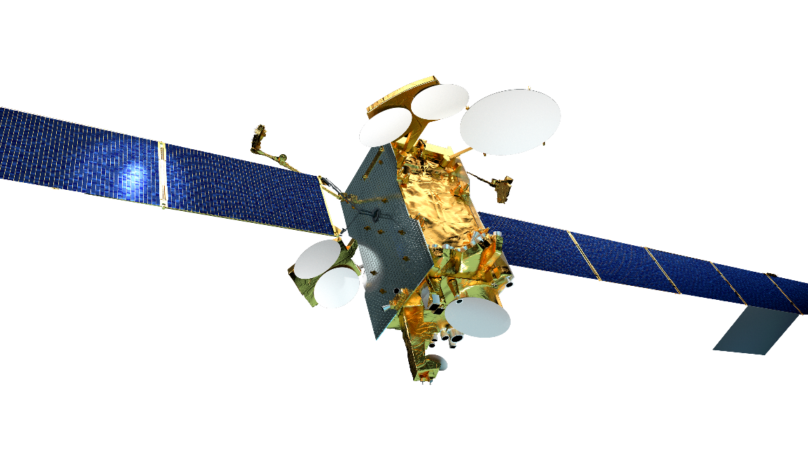
Global-scale Observations of the Limb and Disk (GOLD) – First Light Observations
William McClintock
Laboratory for Atmospheric and Space Physics
University of Colorado

Slide 2
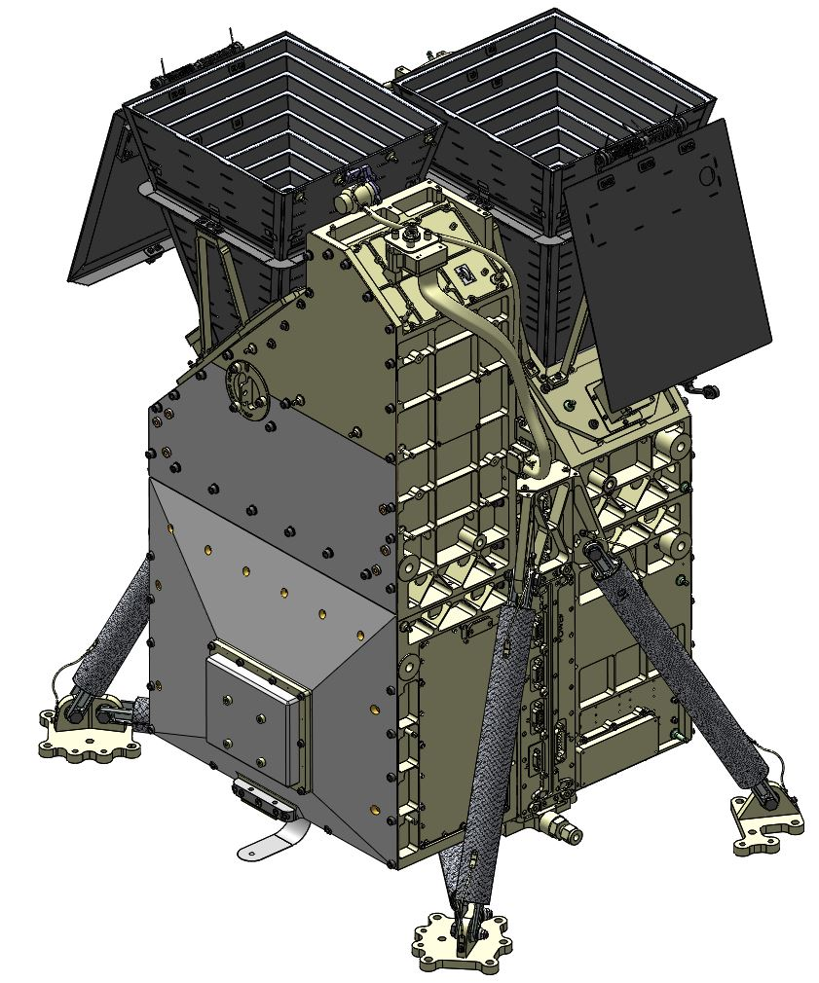
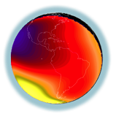
GOLD Mission Overview
GOLD Provides a new Perspective for I-T Science
NASA Explorers Mission of Opportunity
LEO missions enabled the characterization of the I-T system ‘climate’
GOLD, at GEO, enables the first characterization of the I-T system ‘weather’
Host Mission
SES-14, in geostationary orbit at 47.5˚ west
Measurements
Earth’s disk
Daytime: Spatial-spectral image cubes of O-135.6 nm and N₂-LBH emission
Nighttime: Spatial-spectral image cubes of O-135.6 nm emission
Earth’s limb
Altitude profiles of N₂-LBH emission
Stellar occultations

Slide 3
Implementing the GOLD Mission
Global Scale Imaging of the Ionosphere – Thermosphere
In 2005, viewing from geostationary orbit was clearly the preferred approach
For > 2019, constellations of cube-sats might provide complementary/ more-comprehensive data
Propose GOLD as a Mission of Opportunity (MOO)
Cost of a dedicated NASA mission was beyond the resources available in the SMEX Program
Programmatic Approach
GOLD’s approach: partner with a Com-Sat Owner-Operator for proposal submission. The ride was procured as a subcontract from LASP to SES Government Solutions (USA company)
Other models we chose not to employ:
Partner with a Com-Sat builder to provide a satellite-hosted payload to a Com-Sat Owner-Operator at reduced cost
Manage the procurement of the accommodation through the Explorers Office or through the Airforce HOPS program
Technical Considerations
SES selected the ride just before PDR. Having a very complete interface requirements document for spacecraft vendors was absolutely key in avoiding proposal cost uppers.
We were able to use simple approaches to defy conventional wisdom and integrate an ultraviolet remote sensing instrument on what the world thinks is a ‘dirty class of spacecraft’

Slide 4
O-135.6 nm Emission Nightime Movie
The morphology and rapid evolution of plasma bubbles was a surprise to the team
Image Cadence
30 minutes 1700:2000 hrs
15 minutes 2000:2045 hrs
Plasma density depletions (bubbles) produce O-135.6 nm emission ‘bite-outs’ perpendicular to the equatorial arcs

Slide 5
O-135.6 nm Emission Nightime Movie
The morphology and rapid evolution of plasma bubbles was a surprise to the team
Image Cadence
30 minutes 1700:2000 hrs
15 minutes 2000:2045 hrs
Plasma density depletions (bubbles) produce O-135.6 nm emission ‘bite-outs’ perpendicular to the equatorial arcs

Slide 6
What’s Next?
GOLD is a pathfinder for science investigations to study the global-scale behavior of the I-T system on short timescales.
Programmatically, GOLD has demonstrated that a partnership with a Com-Sat Owner-Operator is a viable approach for delivering a science payload to GEO. There were people at NASA who never believed that this was possible.
Technically, GOLD has demonstrated that it is straight forward to integrate a NASA science instrument with Com-Sat spacecraft even though the provider was headquartered in Toulouse, France. There were people at NASA who never believed that this was possible.
The number of future programs that can build on GOLD’s experience is limited only by people’s ingenuity. I hope everyone at NASA believes this is possible.

Slide 7
Thank You

Slide 8
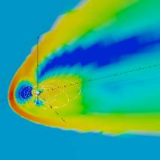
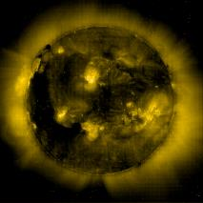
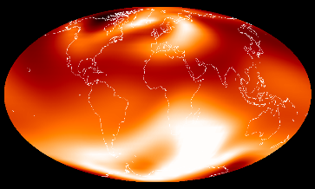
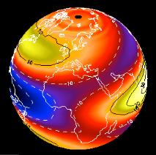
Forcing of the Thermosphere-Ionosphere
Four Scientific Questions Frame the Mission
Forcing from Above
Science Question 1 (Q1). How do geomagnetic storms alter the temperature and composition structure of the thermosphere?
Q2. What is the global-scale response of the thermosphere to solar extreme-ultraviolet variability?
Q4. How does the nighttime equatorial ionosphere influence the formation and evolution of equatorial plasma density irregularities?
Thermosphere-
Ionosphere
Q3. How significant are the effects of atmospheric waves and tides propagating from below on thermospheric temperature structure?
Forcing from Below
Notes:
Science Questions 1-4

