Slide 1
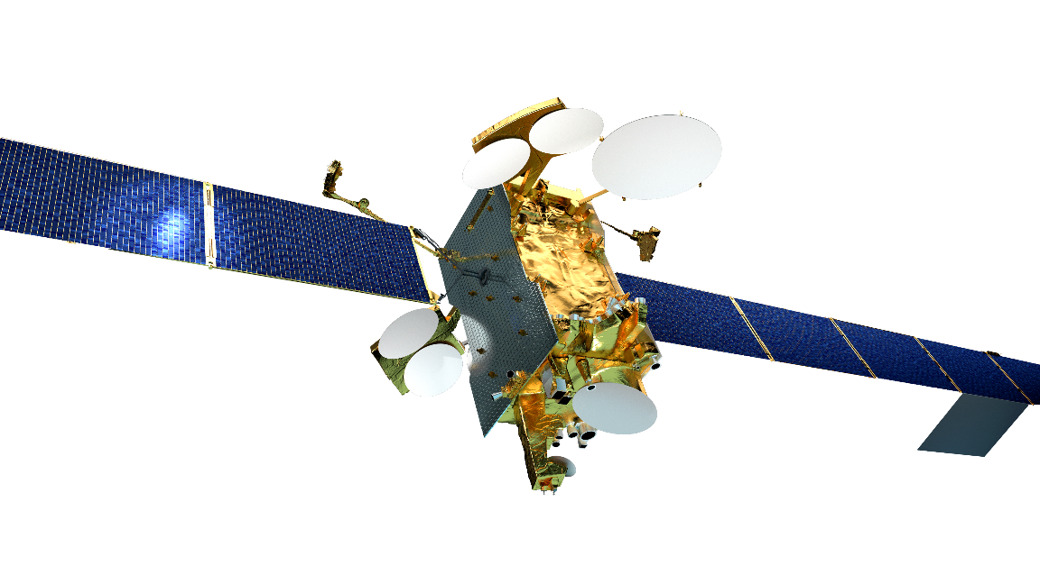
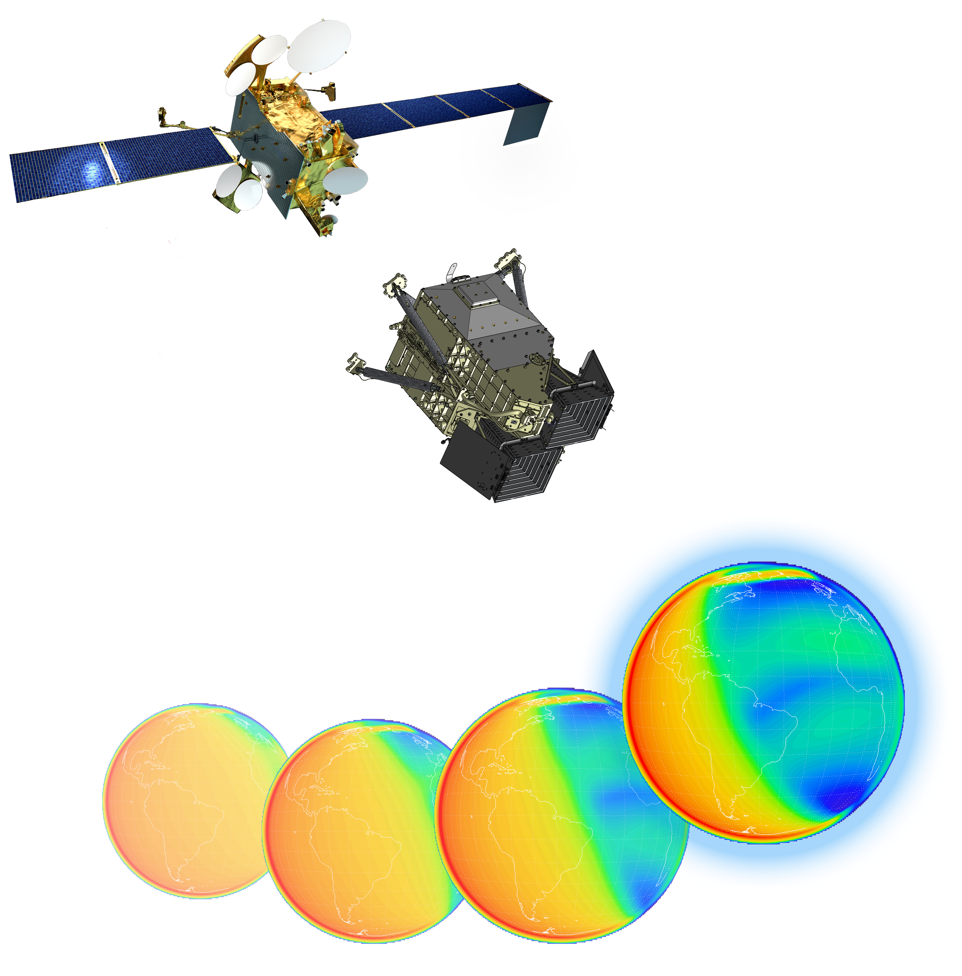




Global-scale Observations of the Limb and Disk (GOLD): Early Orbit Observations
R. Eastes, A. Burns, W. McClintock, S. Solomon & the GOLD Team

Slide 2
Outline
Mission
Instrument operations
Observations & data products

Slide 3
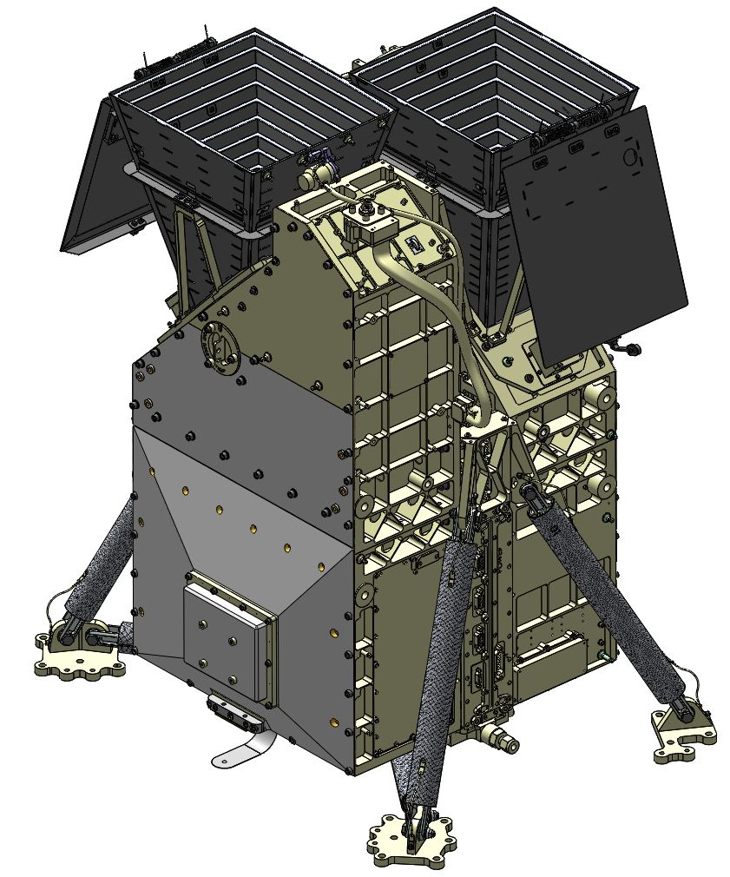
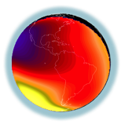

GOLD Mission
NASA Mission of Opportunity, Imaging I-T System from GEO
Host Mission
  SES-14, in geostationary orbit at 47.5˚ west (over mouth of the Amazon River)
GOLD Instrument
  Two identical, independent imaging spectrographs covering 132-162 nm
Measurements
  Earth’s disk
    Daytime: O/N₂ (density ratio) and temperature in lower thermosphere
    Nighttime: peak density in ionosphere
  Earth’s limb
    Exospheric temperature and O₂ density profile
Notes:
Images of O/N2 and T near 160 km.
O2 Density profile 140-240 km

Slide 4
GOLD Daily Observation Example
Spacecraft Local Time
00:00
03:00
08:00
CH A
CH B
Solar Safe
Dayside Disk Imaging, Dayside Limb Scans, and Stellar Occultations
08:00
12:00
16:00
CH A
CH B
16:00
17:00
20:00
21:00
24:00
CH A
CH B
Nightside Disk Imaging, Dayside Disk & Limb Scans, and Occultations
Solar Safe
Observations of Earth’s Space Environment
 |  | Dayside Disk Imaging |  | Dayside Limb Scan
 |  | Nightside Disk Imaging |  | Stellar Occultations

Slide 5
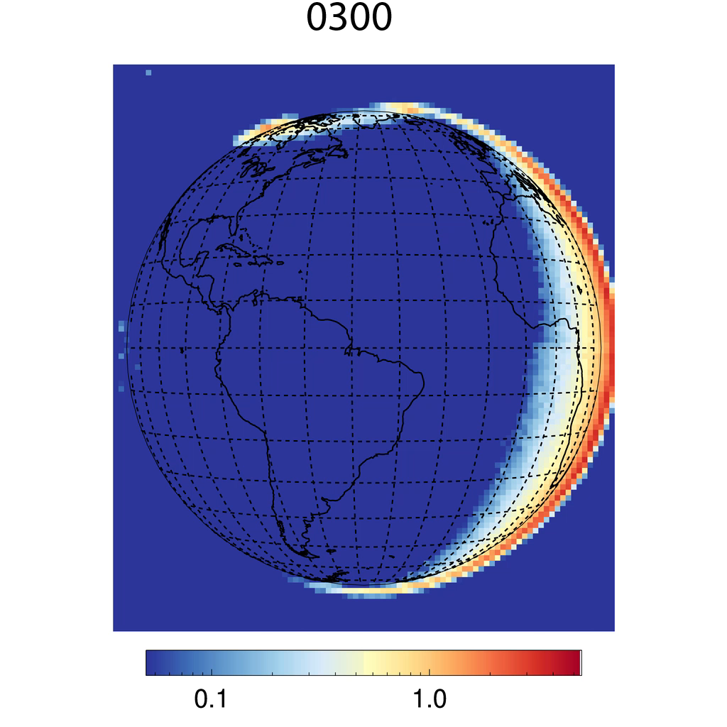
Imaging at 135 nm, October 9 (Day 282)
0300-2000 LT (0600-2300 UT) observations by Channel A
Low resolution mode (0.35 nm)
Sum of 135.6 nm emission, primarily from atomic oxygen (O)
30 minute cadence for whole image, spatial grid is 125 km x 125 km at nadir
Combined scans of north and south latitudes from L1C data
Brightness [kR]

Slide 6
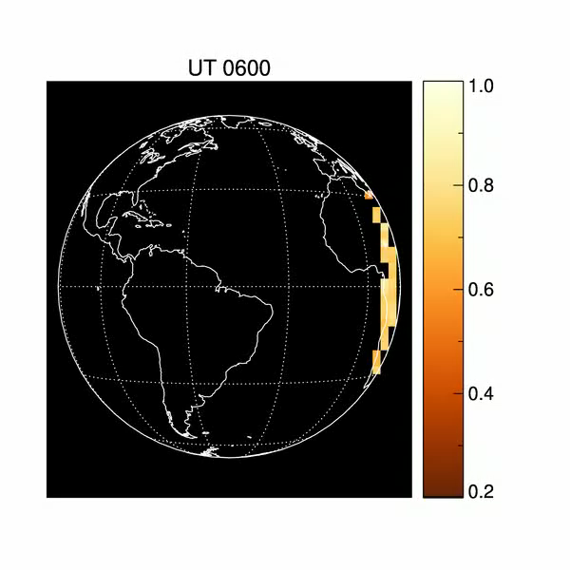
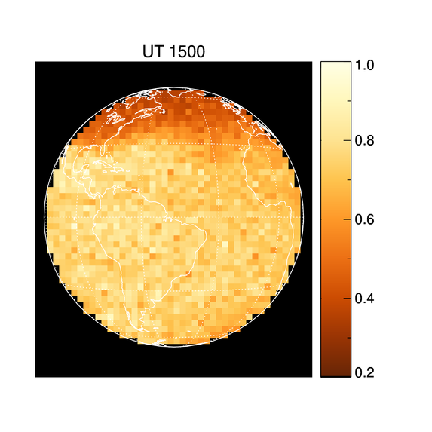
Imaging of O/N₂ Density Ratio
Sept 11 (Day 254) of 2018
Sept 11 (Day 254) was first full day of observations, prior to completion of commissioning activities
Geomagnetic storm with Kp >5 began at ~3 UT (~midnight GOLD LT)
Oxygen density near 160 km in northern auroral region decreased significantly
Further details in SA21A-3169
O/N₂ Density Ratio
Correira - CPI
Correira - CPI

Slide 7
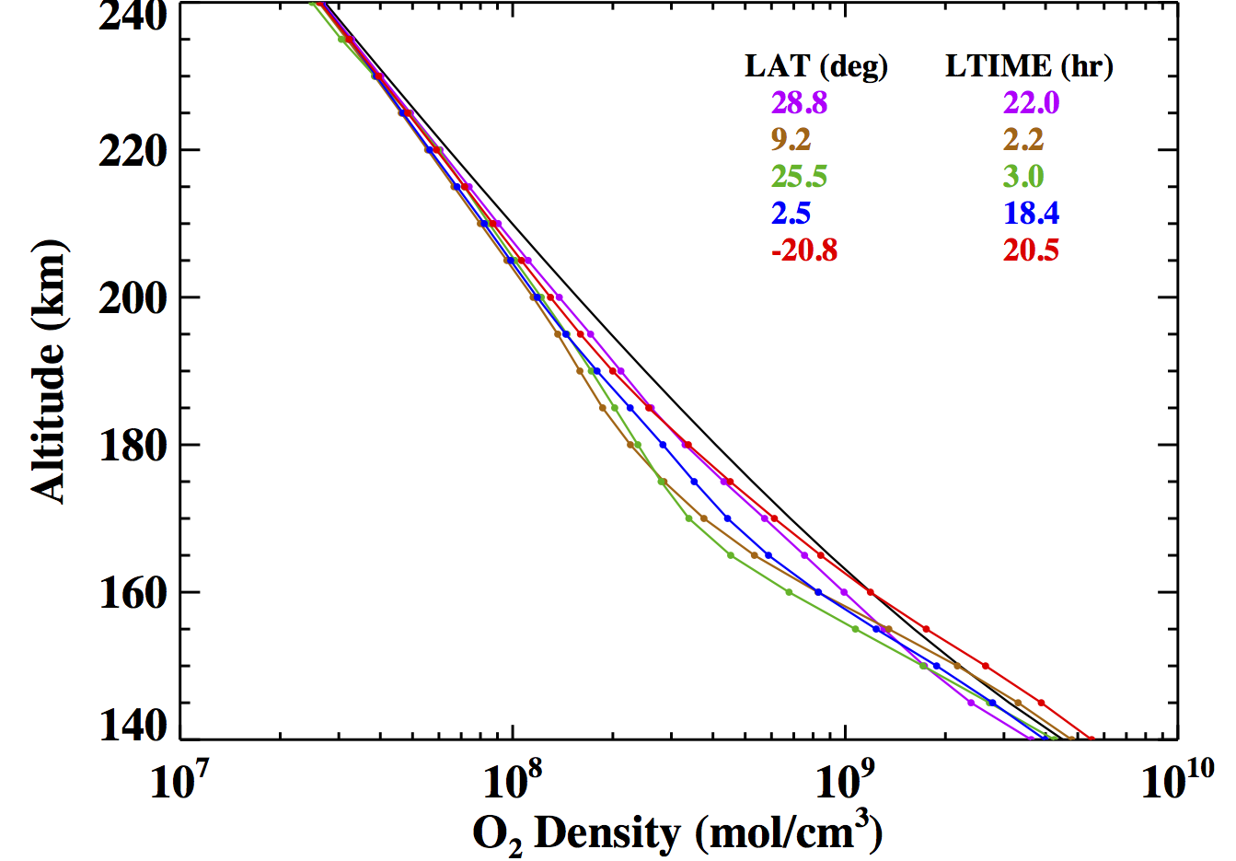
Stellar Occultations for O₂ Density
Nightside Retrievals
October 23, 2018 (Day 296)
Black line is a priori MSIS O₂ profile for low solar activity
Local times are at tangent point
Decrease near 180 km is typical
Decrease is consistent with some recent predictions (see SA13B-2769)
Further details in SA21A-3170
Altitude (km)
Preliminary
J. Lumpe - CPI
O₂ Density (mol/cm³)

Slide 8

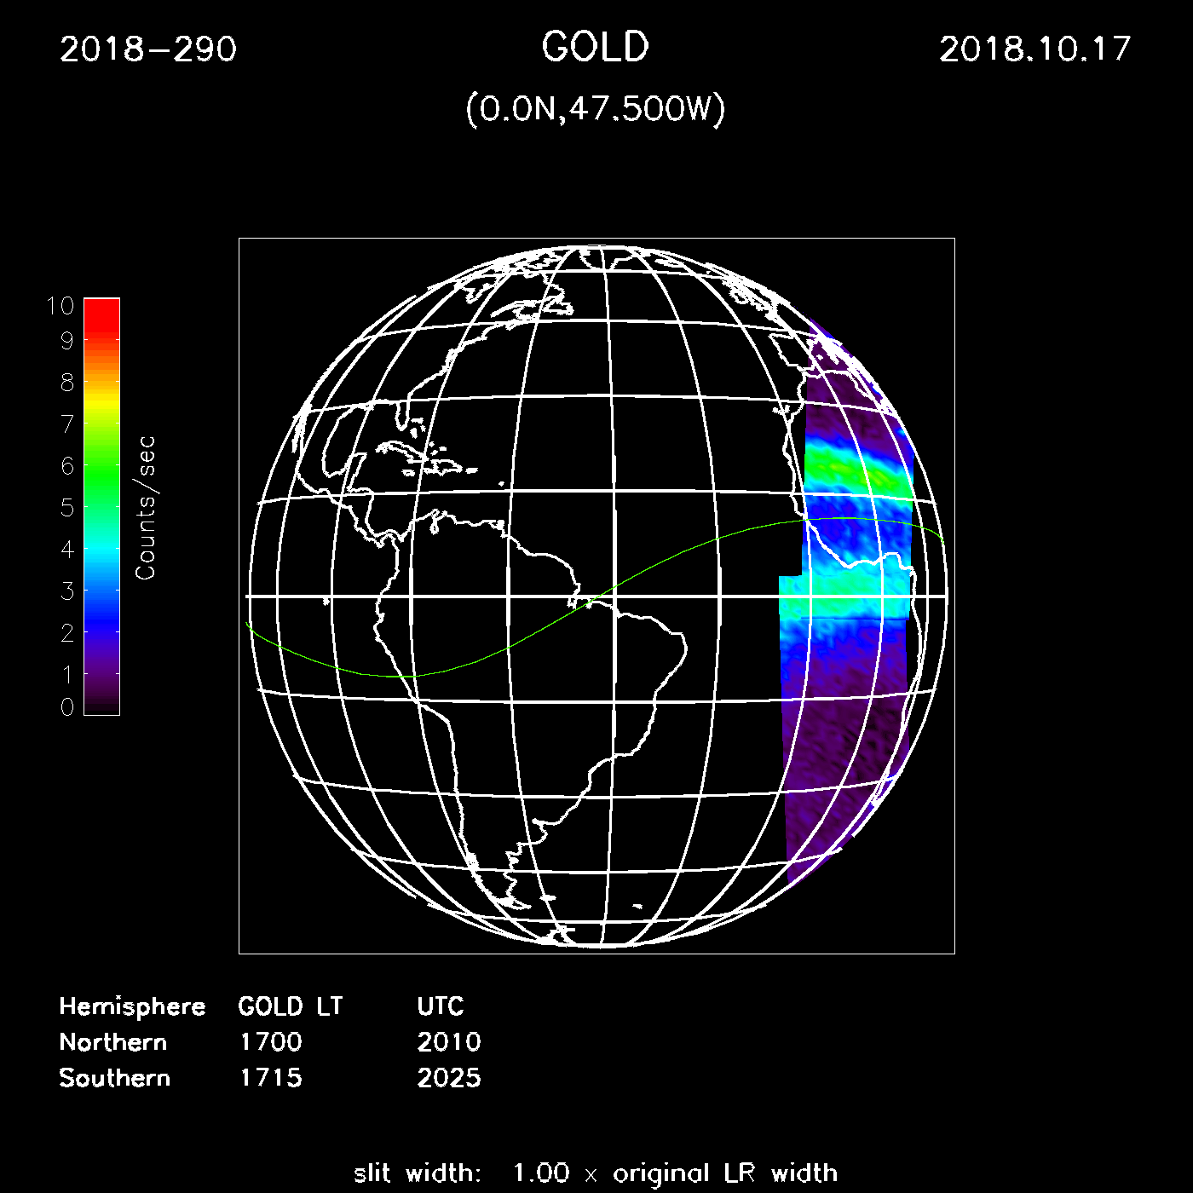
Nightside Observations
October 17, 2018 (day 290)
Observing emissions from Appleton anomaly (O 135.6 nm)
Single channel alternating high and low latitudes 17-20 LT; 30 min imaging cadence
Both channels 20-21 LT; 15 min imaging cadence
Green line is magnetic equator
Western longitudes offset from terminator
(longer movie at CPI display)
R. Daniell

Slide 9
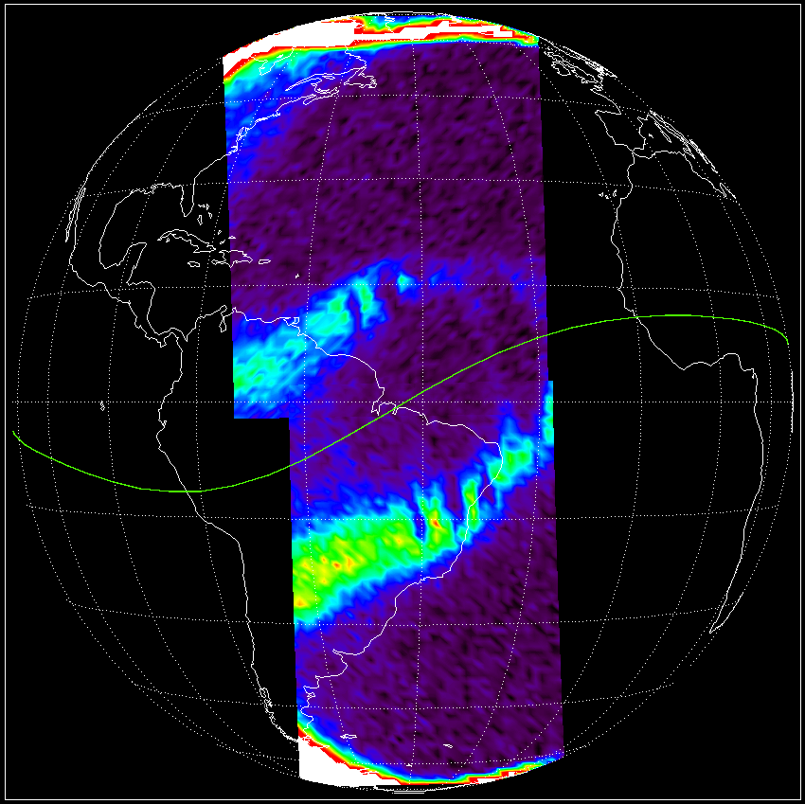
Summary
Instrument launched in Jan. 2018
Two year mission operations began October 2018
Instrument is delivering excellent performance, consistent with test and calibration data
Data products now being validated by science team
L2 data release March 2019
R. Daniell
Notes:
GOES-13 is at 75° West longitude

Slide 10
More Details & Information
For more see the following presentations:
SA11A-07: Observations and Modeling of Atomic/Molecular Composition in the Thermosphere
SA13A-02: Science on Communications Satellites: A Low-Cost Platform for Observing Earth from Geostationary Orbit
SA13B-2769: Heat flow from the upper to the lower thermosphere
SA21A-3169: Global-scale Observations of the Limb and Disk (GOLD): Overview of ON2 and QEUV Science Data Products
SA21A-3170: Initial Measurements of Thermospheric O₂ Density Profiles from GOLD
SA21A-3171: Global-scale Observations of the Limb and Disk (GOLD): Overview of Daytime Exospheric Temperature Science Data Product
SA21A-3172: Global-scale Observations of the Limb and Disk (GOLD): Overview of Daytime Neutral Temperature Science Data Product
SA21A-3175: Inference of thermospheric temperature profiles from GOLD disk images and applications for tracking Traveling Atmospheric Disturbances
ED31A-01: Revolutionizing our understanding of the space environment: A data visualization tool for the NASA GOLD Mission
- GOLD web site http://gold.cs.ucf.edu

Slide 11
Thank You
- GOLD web site http://gold.cs.ucf.edu

Slide 12
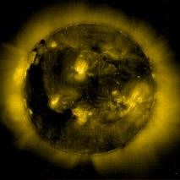
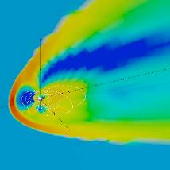
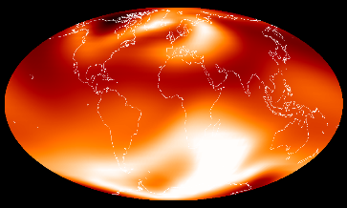
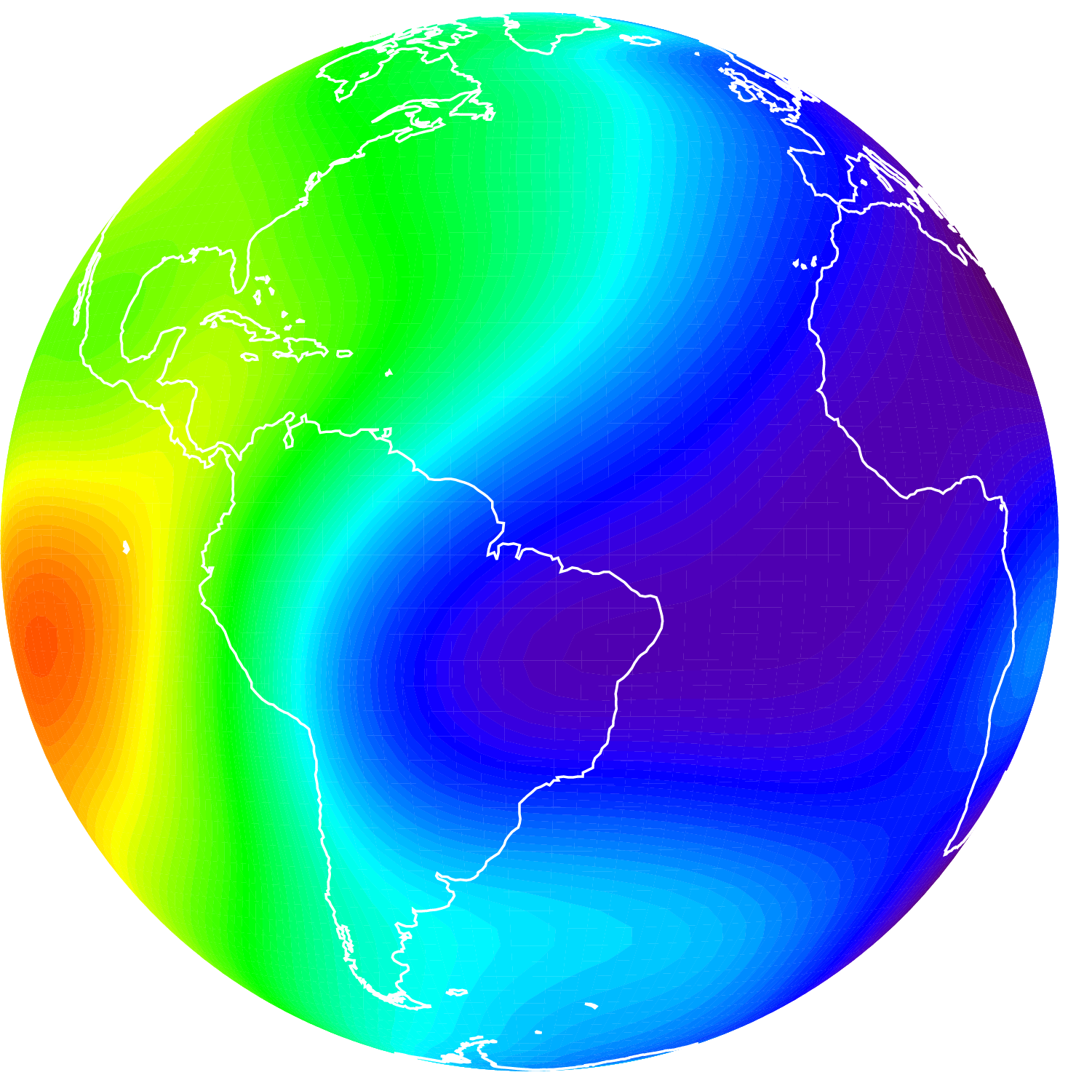
Forcing of the Thermosphere-Ionosphere
Forcing from Above
Q2. How does the thermosphere respond to solar ultraviolet variability?
Science Question 1 (Q1). How do geomagnetic storms affect the thermosphere?
Q4. How does the nighttime equatorial ionosphere respond?
Thermosphere-
Ionosphere
Q3. How do atmospheric waves and tides affect the temperature of the thermosphere?
E. Becker
Forcing from Below
K. Greer
Notes:
Science Questions 1-4, paraphrased

